Slide 1
Welcome to
Presentation Session of Internship
Final Examination

Slide 2
Internship Title Web Design And Development

Slide 3
Internship
Presented By:
Bishajit Chakraborty
2018000000010
Batch-48
Shimul Chandra Shil
2017000000139
Batch-45
Supervisor:
MD. Ashraful Hoque
Lecturer & Coordinator
Department of CSE
Southeast University
Co-Supervisor:
Md. Sohrab Uddin
CEO Aajhat.com

Slide 4

Outline
About The Company
Our Responsibilities
Front-End Technologies
Back-End Technologies
Demonstration And
Learning Outcome

Slide 5
About The Company
Aajhat.com is a new modern brand and digital marketing agency in Bangladesh.
They try to create a platform of E-commerce website selling and also provide a best service for them.
They have expertise in branding, innovation, design, digital marketing and Social Media and analytics to drive measurable results for aajhat.com.
They provide a holistic suite of market-leading services marketing solutions for small businesses to bespoke brand strategies, branding systems and fully integrated digital campaigns for larger enterprises.

Slide 6
Our Responsibilities
We are working as a full-stack web application developer in Aajhat.com. We are responsible for implementing logic and creating API according to design and PRD(Project requirement document).

Slide 7
Front-End Technologies:
Front-End Design using Tailwind CSS, SAAS.
Data Integration using React js
Data Integration using Redux(Redux Thunk)

Slide 8
Back-End Technologies:
For Back-End using Django.
Using Django-Rest-Framework(DRF)

Slide 9
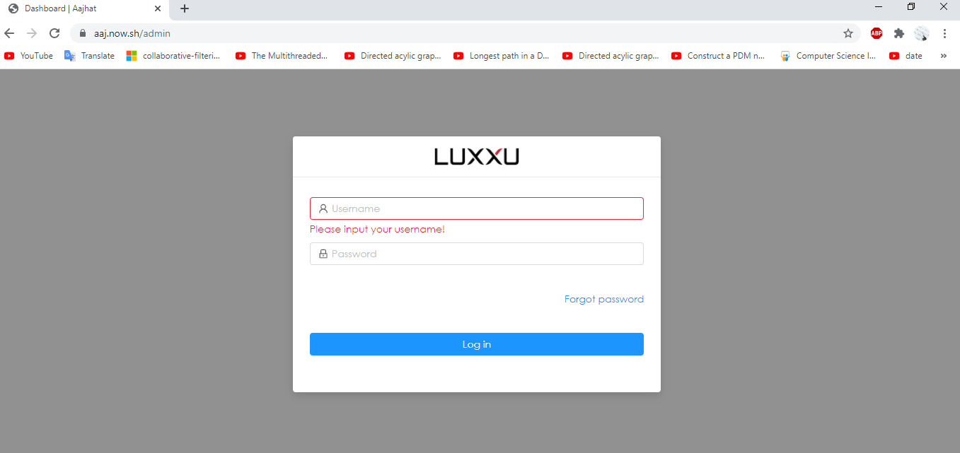
Some Graphical View of my work:

Slide 10
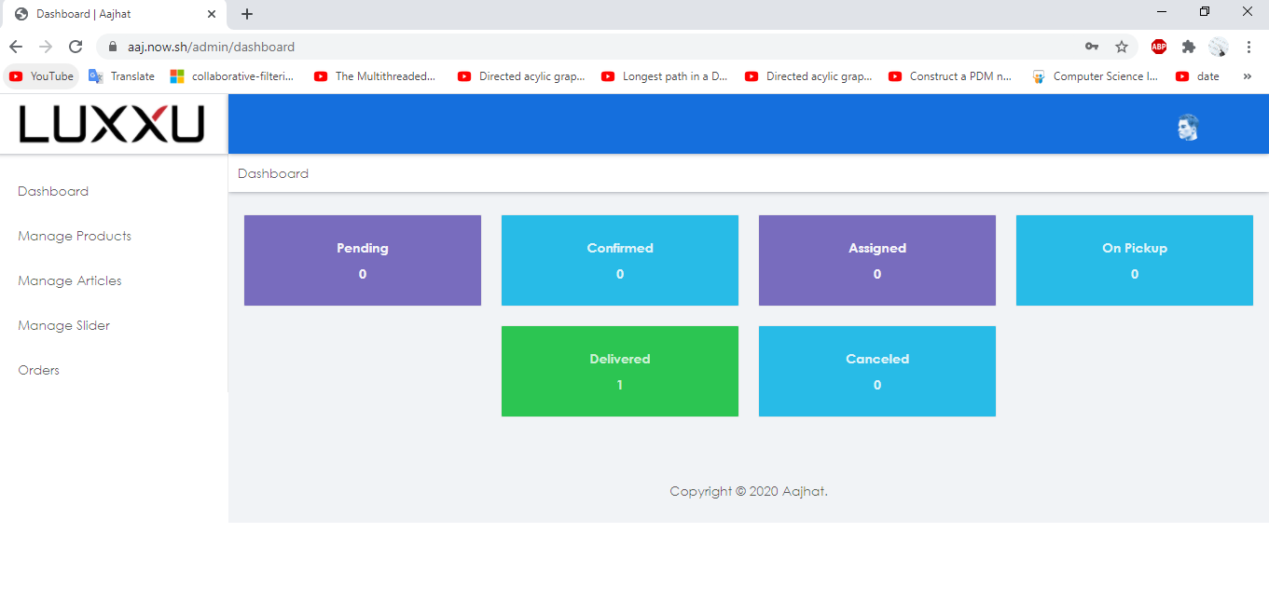
Some Graphical View of my work:

Slide 11
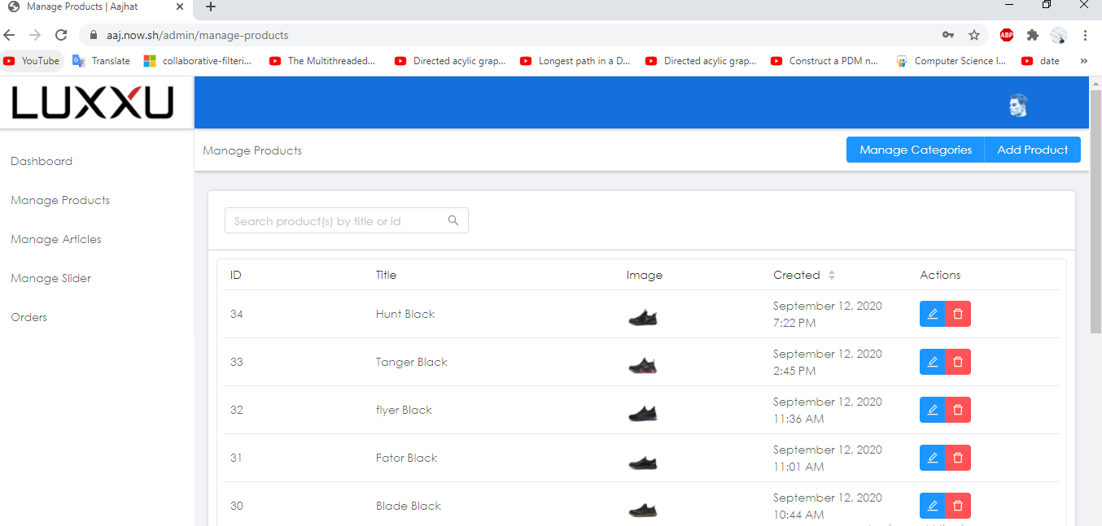
Some Graphical View of my work:

Slide 12
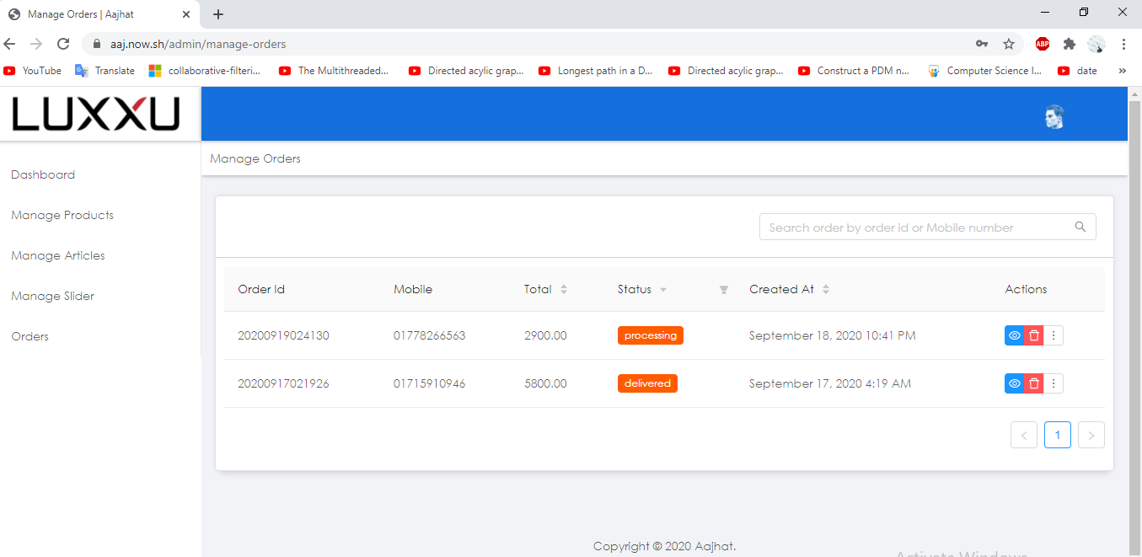
Some Graphical View of my work:

Slide 13
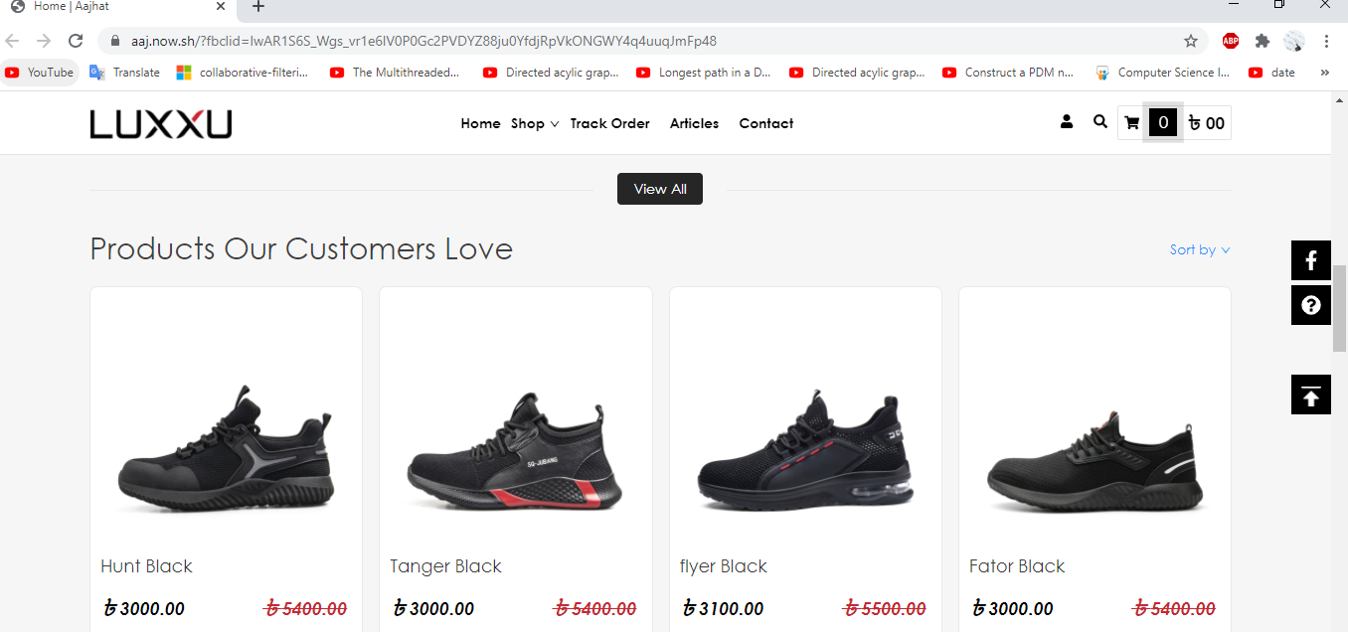
Some Graphical View of my work:

Slide 14
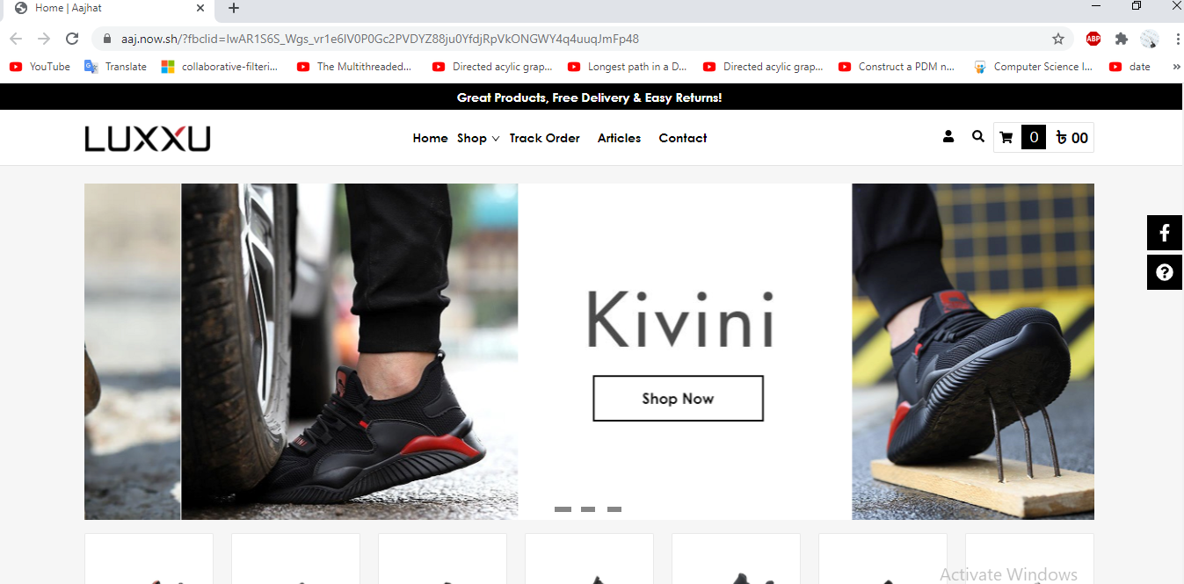
Some Graphical View of my work:

Slide 15
Learning Outcome
Learned more about Django
Learned about React js
Learned HTML
Learned Tailwind CSS
practice of clean coding
trained me to finish the task properly at proper time
Improved working skill as a team member
Learned how to manage time

Slide 16
THANK YOU

Slide 17
Any Questions? ☺

